Slide 1



AI-Powered Website Building
with Astro
A prompt-first class outline using Claude Code or Antigravity to build from compiled company assets and text.
Workshop focus
• No manual scaffolding lesson
• AI agent runs setup/build steps
• Students learn prompting + review
• Final site goes live on Vercel
Compile assets
Prompt the AI
Review locally
Deploy

Slide 2
Class Goal
Participants build by prompting an AI coding agent, then reviewing and launching the result.
Use AI to turn a prepared folder of company assets into a mobile-optimized Astro static website deployed on Vercel.
Assets
Design
Plan
Build
Launch
Knowledge base
design.md
implementation-plan.md
Astro site
Vercel + domain
Important: the class is not about manually scaffolding Astro. It is about briefing, supervising, testing, and iterating with the AI.

Slide 3
Tools and Accounts
Prerequisites stay lightweight; the AI agent handles most technical steps.
Required
Nice to Have
• Node.js installed
• Git installed
• Homebrew if on macOS
• GitHub account
• Vercel account
• Razorpay or PayPal if payments are needed
• Gemini Pro, Claude, or ChatGPT subscription
• Claude Code or Antigravity IDE
• VS Code as backup
• GoDaddy or other domain provider
• Resend for email forms
• Prepared assets folder before class

Slide 4
Prepare the Company Asset Folder
This is the main human task before the AI starts coding.
Suggested folder
Collect
company-assets/
content/
about.md
services.md
team.md
locations.md
faq.md
images/
videos/
docs/
listings/
design/
inspiration/
links.md
• Pictures: logo, team, product, service, hero
• Videos and YouTube links
• PPTX, pitch decks, PDFs
• Google Business Profile details
• Airbnb, TripAdvisor, booking listings
• Instagram, YouTube, LinkedIn, WhatsApp
• Booking, Razorpay, PayPal links

Slide 5
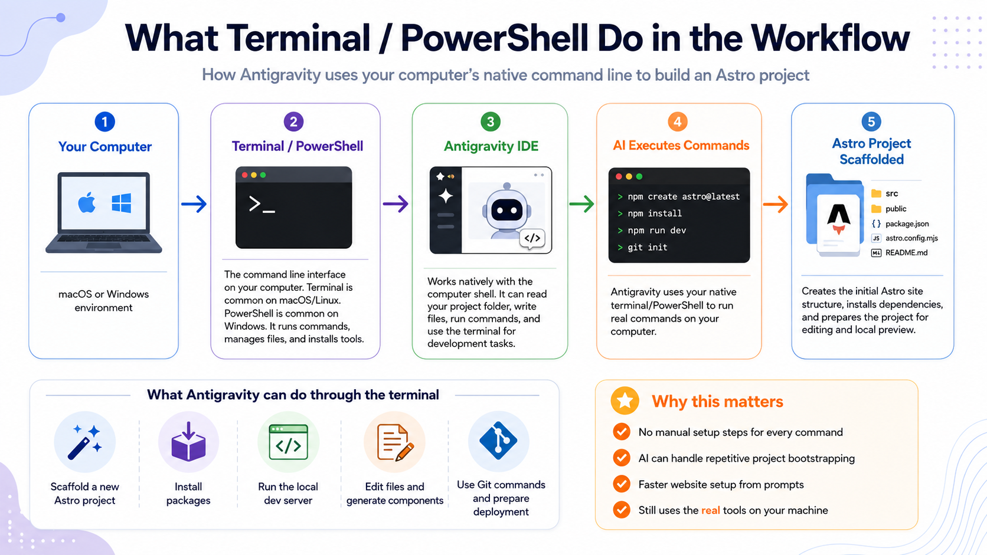

Slide 6
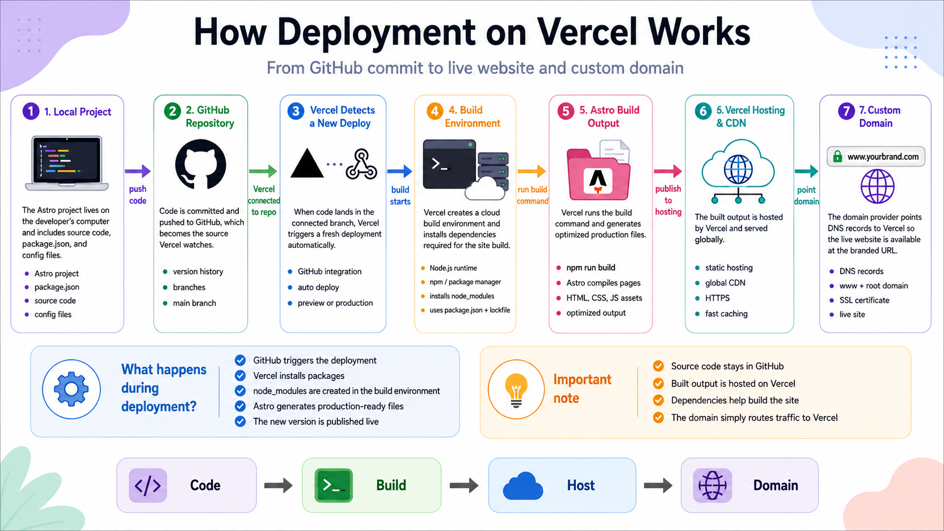

Slide 7
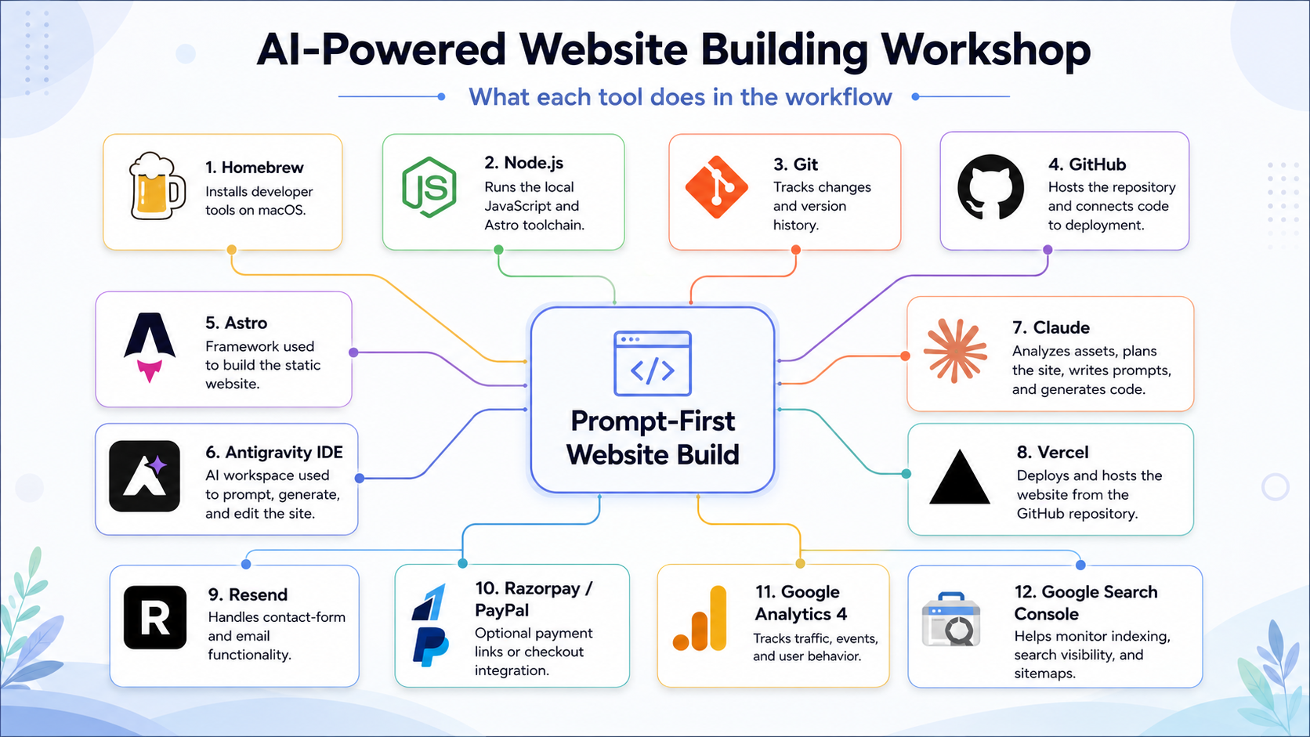

Slide 8
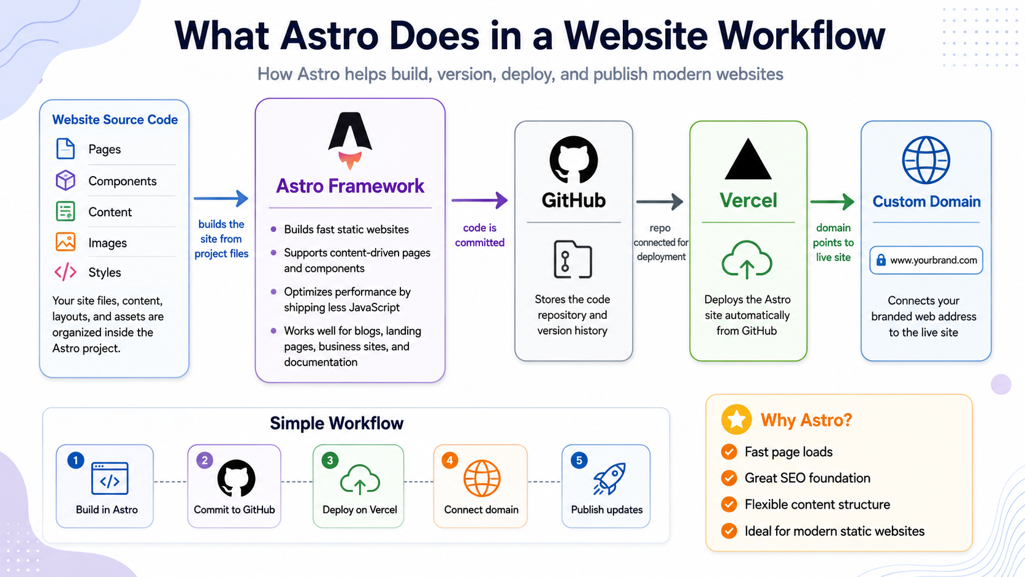

Slide 9
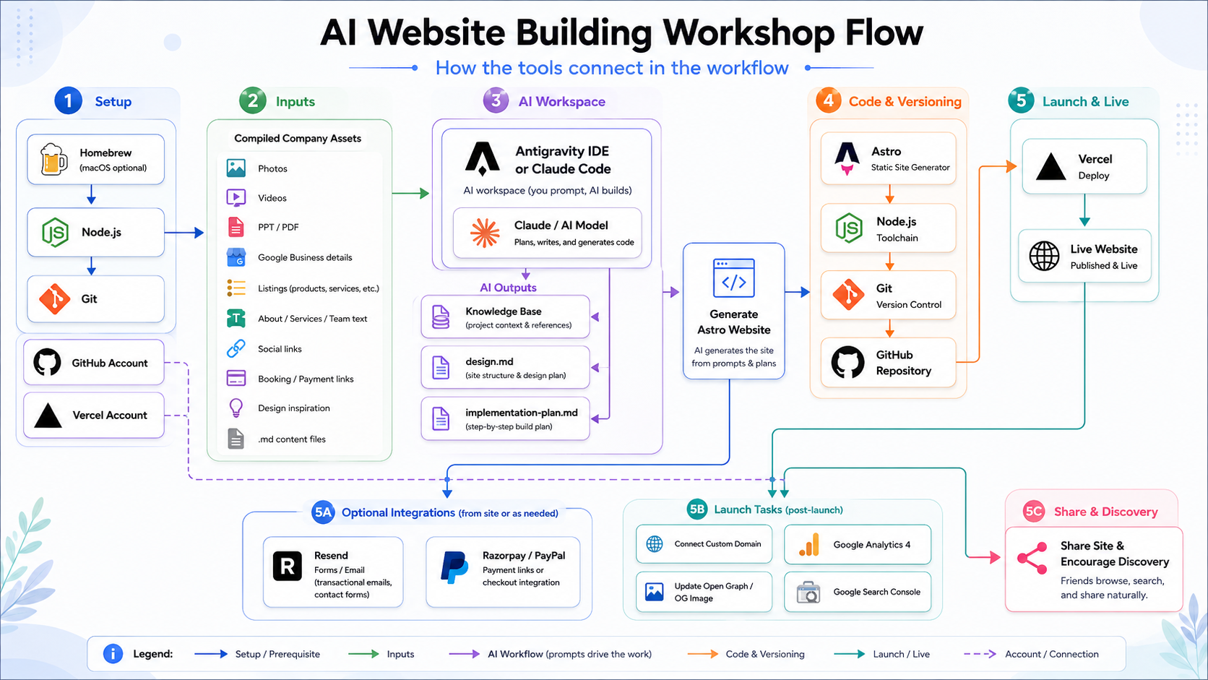

Slide 10
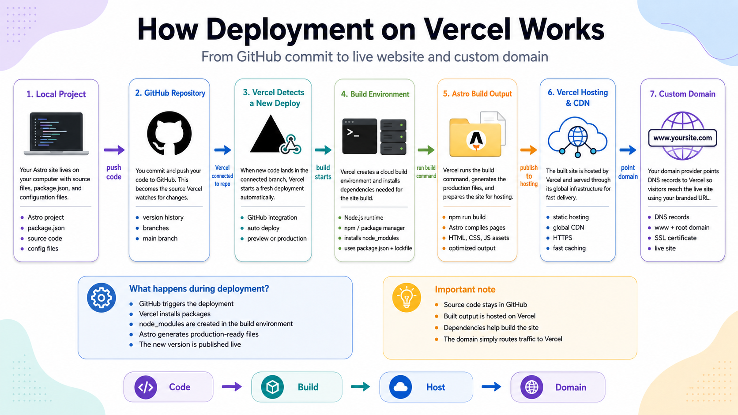

Slide 11
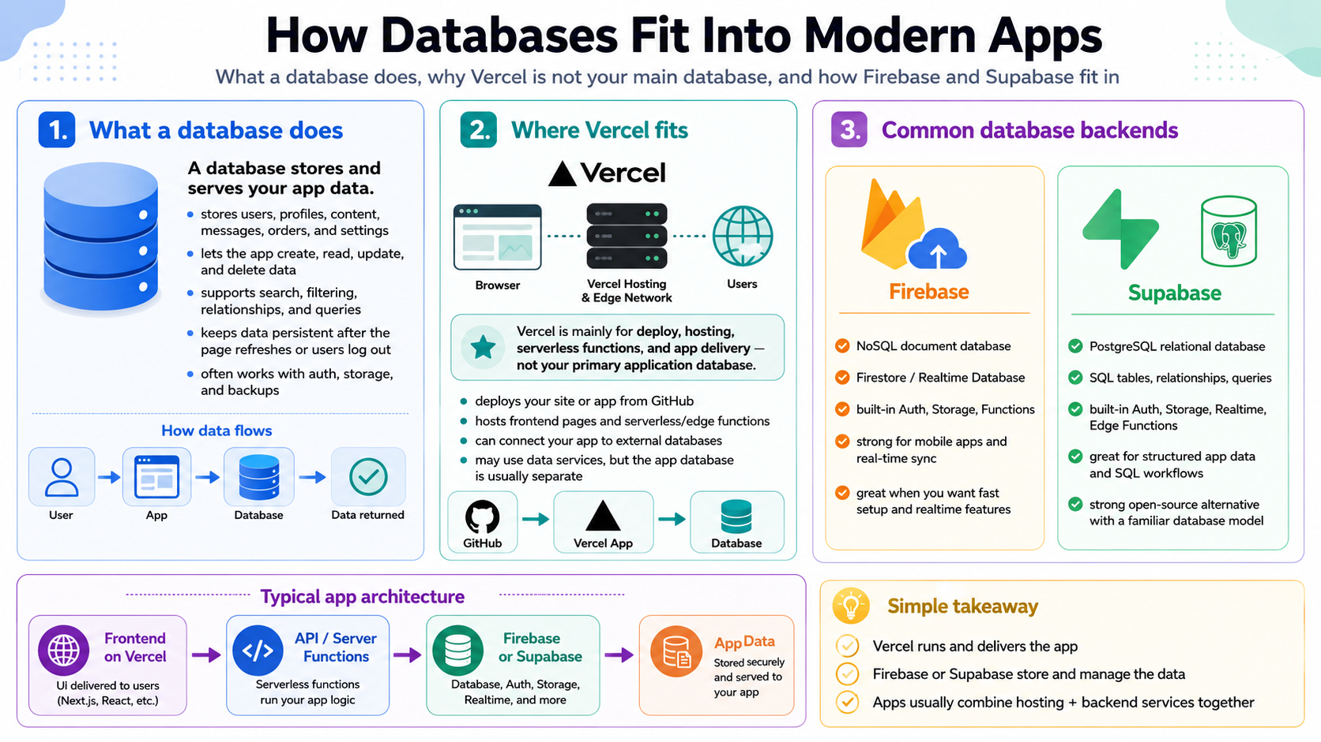

Slide 12
Prompt Flow for the Class
Do not jump straight to “build a site.” Make the AI understand, design, plan, then build.
1
Analyze assets
2
Create KB
3
Create design.md
4
Create implementation plan
5
Build Astro site
6
QA + fix loop
7
Deploy + finalize
Each prompt produces a reviewable output. The learner approves or corrects before moving to the next prompt.

Slide 13
Prompt 1: Analyze the Business
Create a knowledge base from the compiled company assets.
Copy-paste prompt
Review / approve
We are creating a website for [COMPANY].
Use the provided company-assets folder. The site will be built with Astro and deployed on Vercel through GitHub.
GitHub username: [ ]
GitHub email: [ ]
Repo URL: [ ]
Do not build yet. Analyze all assets and create knowledge-base.md with: identity, offerings, audience, tone, locations, CTAs, booking/payment links, social links, and missing content questions.
• knowledge-base.md
• Missing content questions
• Assumptions to approve
• Clear CTAs and audience

Slide 14
Prompt 2: Create the Design System
Turn brand assets and inspiration screenshots into website design rules.
Copy-paste prompt
Review / approve
Using knowledge-base.md and the design/inspiration assets, create design.md.
Include colors, typography, spacing, buttons, cards, icons, shapes, image treatment, hero layout, section style, mega menu direction, footer style, animations, accessibility, and mobile rules.
Make the design premium, fast, and practical for an Astro static website.
• design.md
• Mobile padding rules
• Section style
• Navigation direction
• Accessibility basics

Slide 15
Prompt 3: Create the Build Plan
Ask for a plan before allowing the AI to code.
Copy-paste prompt
Review / approve
Create implementation-plan.md for the Astro website.
Use knowledge-base.md and design.md. Plan pages, routes, content structure, components, mega menu, footer, SEO metadata, Open Graph, sitemap, robots.txt, analytics, booking/payment links, and optional Resend forms.
Do not code yet. List the files you will create or edit.
• implementation-plan.md
• Page and component list
• SEO/social plan
• Integration plan
• Files to be created

Slide 16
Prompt 4: Build the Website
Now the AI agent can scaffold, install, and code the Astro project.
Copy-paste prompt
Review / approve
Proceed with the implementation plan.
Create the Astro project, add required dependencies, set up folders, and build the site from the assets and Markdown content.
Include responsive pages, mega menu, footer, social links, CTAs, booking links, and optional payment links. Prioritize small-screen mobile layout, including Samsung S23 FE.
After coding, explain how to run locally.
• AI runs setup commands
• Local preview opens
• Core pages exist
• Mobile layout works
• No manual scaffolding lesson

Slide 17
Prompt 5: Review and Fix Locally
Use screenshots and specific issues to guide targeted fixes.
Copy-paste prompt
Review / approve
I reviewed the local site. Please fix these issues only:
[PASTE SCREENSHOTS OR NOTES]
Also audit mobile spacing, header/mega menu, images, broken links, CTAs, accessibility, and visual consistency with design.md.
Make targeted fixes and summarize what changed.
• Desktop and mobile checked
• Every link clicked
• Screenshots used as evidence
• Fix loop repeated until ready

Slide 18
Prompt 6: SEO, OG, and Integrations
Add launch essentials without overbuilding.
Copy-paste prompt
Review / approve
Add launch essentials.
Set up SEO titles, meta descriptions, canonical placeholder, Open Graph tags, Twitter cards, favicon, sitemap.xml, robots.txt, and structured metadata where relevant.
Add booking, WhatsApp, Razorpay, PayPal, or Resend only if relevant. Keep the site static-first and document any environment variables.
• SEO basics added
• OG image ready
• Booking/payment links tested
• .env.example created if needed
• No unnecessary complexity

Slide 19
Prompt 7: Deploy and Finalize
Use the AI to guide GitHub, Vercel, domain, analytics, and Search Console.
Copy-paste prompt
Review / approve
Prepare for launch.
Commit and push to main. Help me connect the GitHub repo to Vercel and fix build errors.
Then guide custom domain setup for [DOMAIN PROVIDER], update canonical and Open Graph URLs, add GA4 Measurement ID [G-XXXX], verify Search Console, submit sitemap, and run final production checks.
• Vercel live URL works
• Custom domain + SSL active
• GA4 real-time verified
• Search Console verified
• Sitemap submitted

Slide 20
Final Deliverables
What participants should have at the end of class.
✓
Company asset folder
Working Astro site
GitHub repo
✓
✓
✓
Markdown content files
Mobile-responsive design
Vercel deployment
✓
✓
✓
knowledge-base.md
Mega menu and CTAs
Custom domain connected
✓
✓
✓
design.md
SEO + Open Graph
GA4 setup
✓
✓
✓
implementation-plan.md
Optional booking/payment links
Search Console setup
✓
✓
Post-launch: share the site naturally, ask real users for feedback, publish useful updates, and monitor GA4 + Search Console.

